Slide 1



CSA0836:– Python Programming for AI Chat Bot for multi-
disease symptom-based urgency Recommendation
MINI PROJECT:- JAN 2024
TITLE:- AI Chat Bot for multi-disease symptom-based urgency Recommendation
GUIDE NAME:- Raveena selvanarayanan
TEAM MEMBERS:- M.Vinod kumar (192111625), Manaswini panda(192219006), Madhavan(192210195)

Slide 2
TITLE :-
AI Chat Bot for multi-disease symptom-based urgency Recommendation using python

Slide 3
TEAM MEMBERS
M.vinodkumar-192111625
Manaswini panda-192219006
Madhavan- 192210195

Slide 4
INTRODUCTION :
In our fast-paced world, the need for quick and reliable healthcare information is more critical than ever.
Individuals often face challenges in assessing the urgency of their symptoms, leading to uncertainty and delayed decision-making.
Recognizing this crucial need, our project introduces a groundbreaking solution – the Symptom-based AI Chatbot for Urgency Recommendation
This innovative chatbot is strategically designed to harness the power of artificial intelligence, offering users intelligent and timely recommendations based on the symptoms they report
With the aim of addressing the pressing need for accessible and accurate healthcare guidance, our project amalgamates advanced technology with medical knowledge

Slide 5
ABSTRACT
This project introduces a Symptom-based AI Chatbot for Urgency Recommendation, utilizing artificial intelligence to deliver intelligent and timely guidance on user-reported symptoms.
Key aspects include advanced Natural Language Processing techniques for robust symptom recognition, an intelligent algorithm for severity assessment, user-friendly interaction, privacy and security measures, continuous learning, and integration with local healthcare services.
The project aims to empower individuals in assessing symptom urgency independently, representing a significant innovation in healthcare technology.
Continuous improvement, user impact, and a commitment to privacy underscore the project's transformative approach to healthcare guidance.

Slide 6
literature survey:
Explore literature on how artificial intelligence is applied in healthcare, with a focus on diagnostics, personalized medicine, and patient care.
Review studies evaluating the effectiveness and limitations of existing AI-driven symptom recognition systems in various healthcare contexts
Investigate the role of chatbots in healthcare, analyzing studies on patient engagement, information dissemination, and symptom assessment
Explore literature emphasizing the importance of privacy and security in healthcare chatbots, considering best practices for handling sensitive health data.
Examine research on user satisfaction and experience with healthcare chatbots, understanding the impact of user-friendly interfaces on communication

Slide 7
hardware requirements :
Server Infrastructure:
Deploy servers to host the chatbot application and handle AI algorithms for symptom recognition and urgency assessment
Data Storage:
Implement a reliable database system to securely store user data, symptom information, and relevant healthcare data.
Networking Equipment:
Utilize robust networking equipment to facilitate seamless communication between the chatbot application, databases, and external healthcare services.

Slide 8
software requirements :
Programming Languages:
Utilize programming languages suitable for AI development, with a preference for Python due to its extensive libraries for natural language processing and machine learning.
Natural Language Processing Libraries:
Implement natural language processing using libraries such as NLTK (Natural Language Toolkit) or spaCy to interpret and comprehend user-inputted symptoms effectively.
Machine Learning Frameworks:
Employ machine learning frameworks like TensorFlow or PyTorch to build and train the AI model responsible for symptom recognition and urgency assessment

Slide 9
proposed model
Develop a robust natural language processing (NLP) system to interpret user-inputted symptoms, accommodating variations in descriptions for enhanced adaptability.
Utilize machine learning (ML) algorithms for symptom recognition and categorization, ensuring the model is trained on a diverse dataset to improve accuracy across various medical conditions.
Design an intelligent algorithm that assesses the severity of recognized symptoms, incorporating medical knowledge and guidelines to determine urgency levels for seeking medical attention.
Implement continuous learning mechanisms, allowing the chatbot to adapt and improve over time based on user feedback and real-world data, enhancing symptom recognition and urgency assessment capabilities
Prioritize user privacy with secure data storage and transmission protocols, ensuring compliance with healthcare data protection regulations to maintain confidentiality

Slide 10
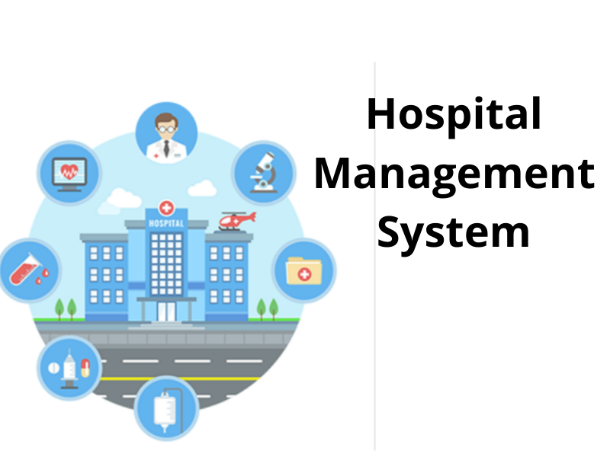
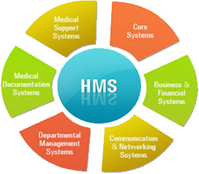

Slide 11
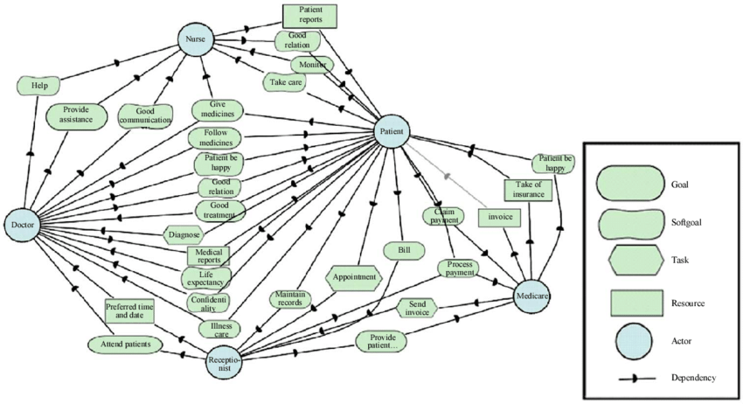
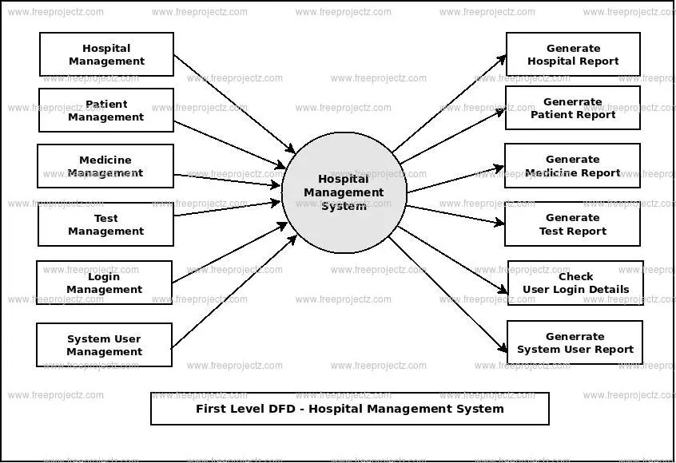

Slide 12
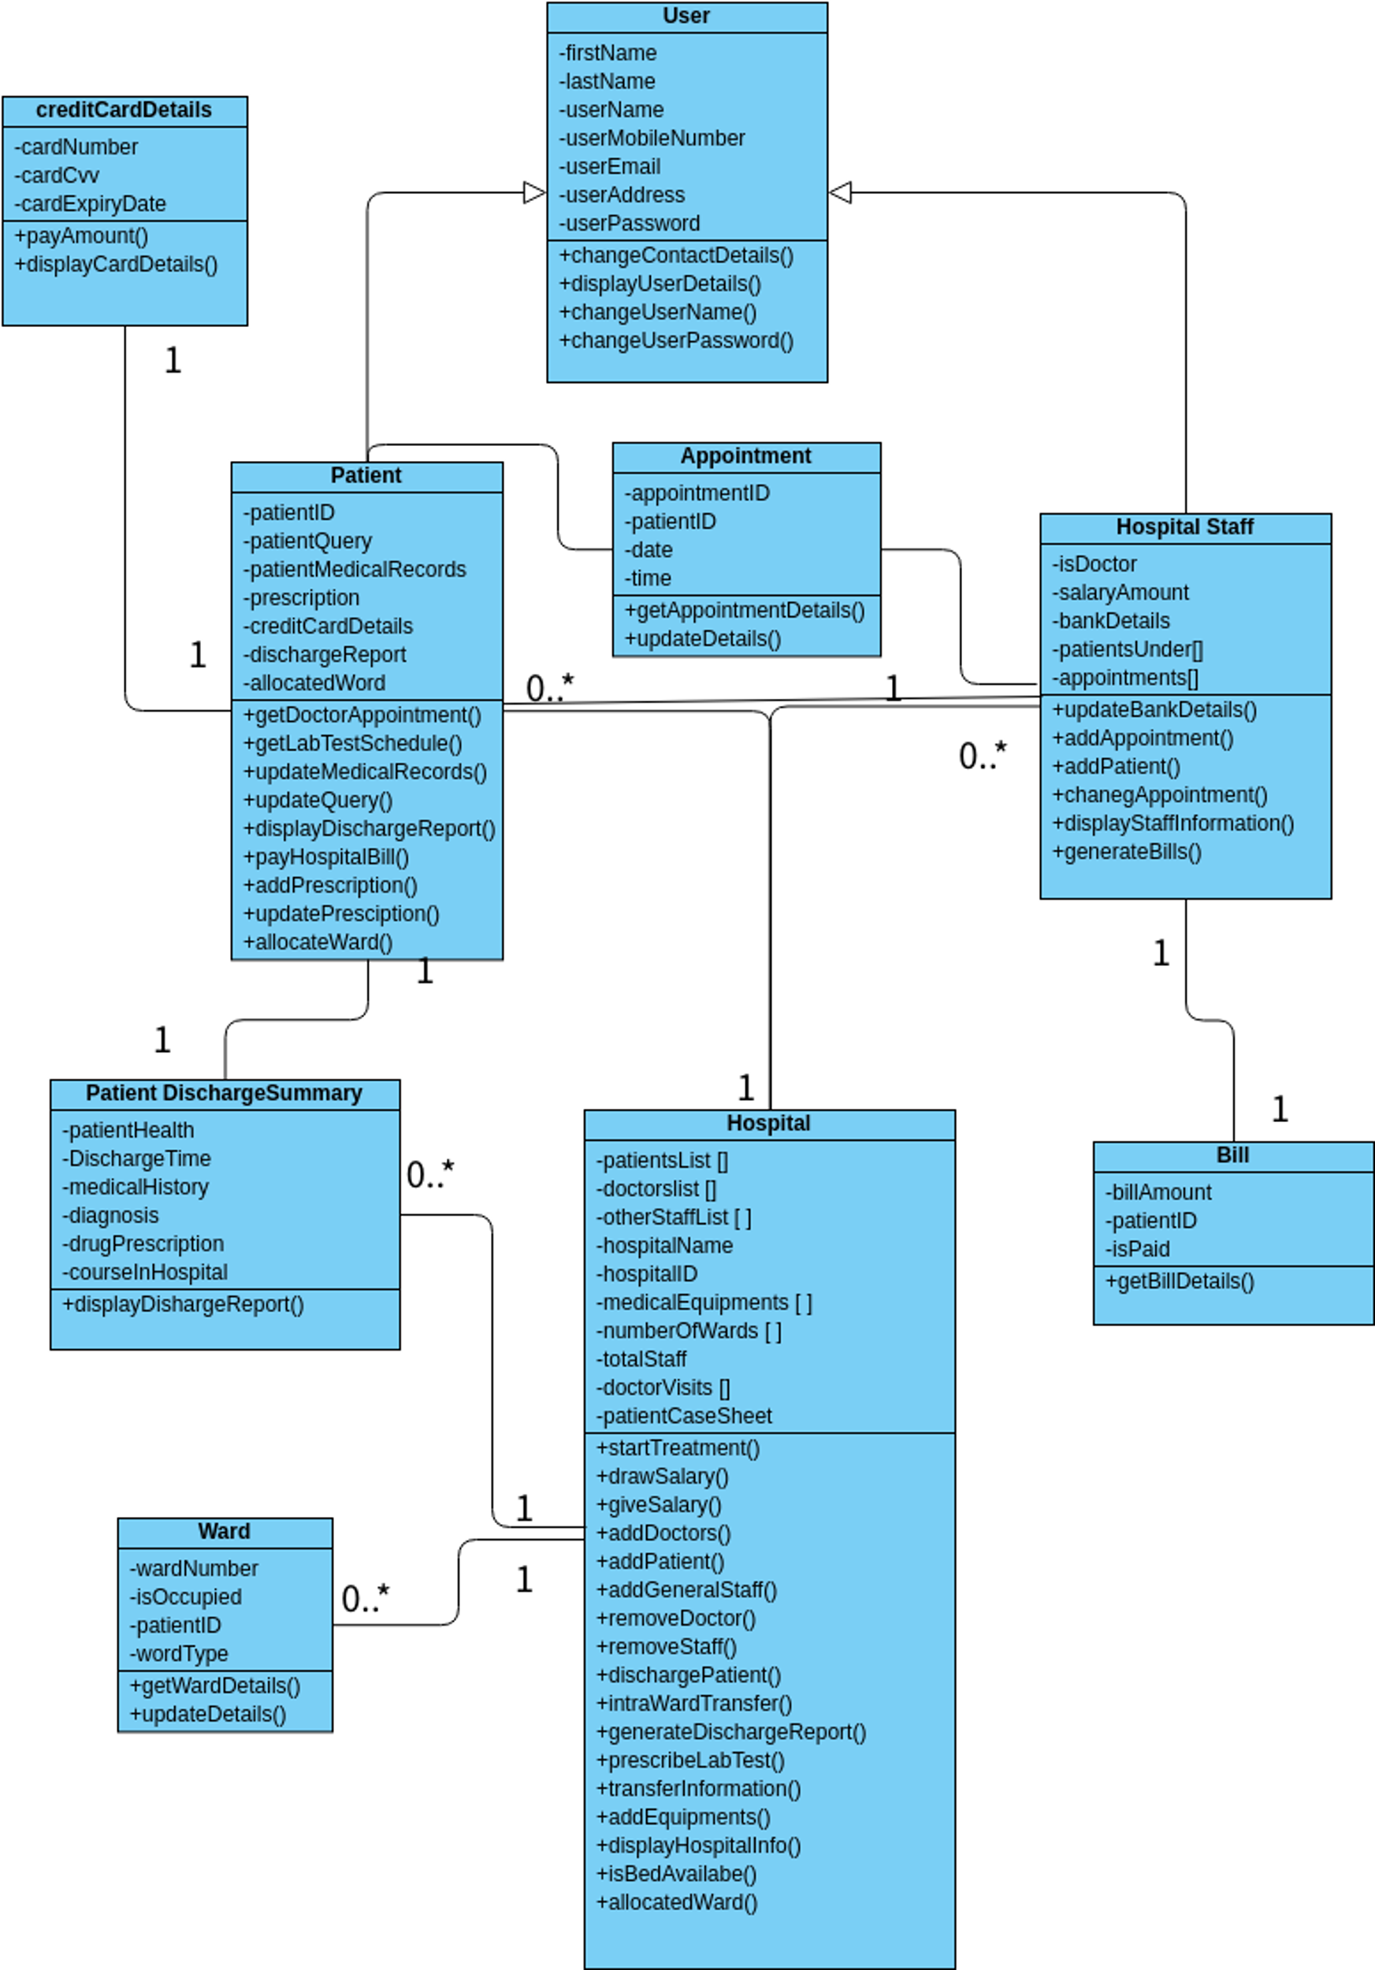

Slide 13
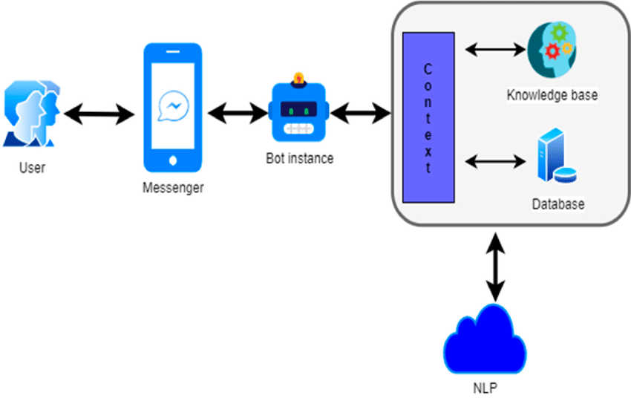
architecture :

Slide 14
coding :
from flask import Flask, request, render_template
app = Flask(__name__)
def recognize_symptoms(user_input):
recognized_symptoms = ["headache", "fever", "cough"]
return recognized_symptoms
def assess_urgency(symptoms):
return "Low"
def home():
return render_template('index.html')

Slide 15
@app.route('/recommendation', methods=['POST'])
def recommendation():
user_input = request.form['symptoms']
recognized_symptoms = recognize_symptoms(user_input)
urgency_level = assess_urgency(recognized_symptoms)
eturn render_template('result.html', symptoms=recognized_symptoms, urgency=urgency_level)
if __name__ == '__main__':
app.run(debug=True)

Slide 16
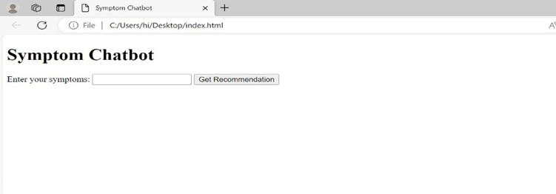
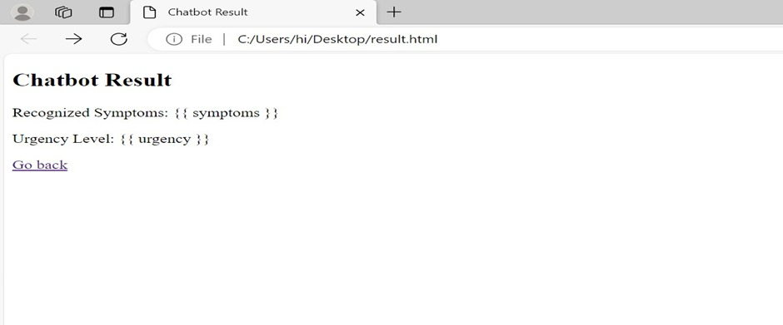
OUTPUT:-

Slide 17
research gap:
Effectiveness of AI Chatbots in Urgency Assessment:
Evaluate whether research has adequately explored the effectiveness of AI chatbots specifically in urgency assessment for diverse medical conditions.
Assess the accuracy, reliability, and user satisfaction levels of existing AI chatbot systems in determining the urgency of symptoms.
User Interaction and Engagement:
Identify if there is limited research on user interaction and engagement with AI chatbots in the healthcare domain.
Explore how users perceive, interact, and engage with healthcare chatbots, focusing on usability and user experience
Integration with Local Healthcare Services:
Investigate whether there's a gap in understanding the challenges and benefits associated with integrating AI chatbots with local healthcare services

Slide 18
References:
Kersting K. Machine learning and artificial intelligence: two fellow travelers on the quest for intelligent behavior in machines. Front Big Data. 2018 Nov 19;
Sathya D, Sudha V, Jagadeesan D. Handbook of Research on Applications and Implementations of Machine Learning Techniques. Hershey, PA: IGI Global; 2020. Application of machine learning techniques in healthcare.
Dahiya M. A tool of conversation: chatbot. Int J Comput Sci Eng. 2017 May 30
Manning M, Weninger C. Analysing discourse: textual analysis for social research, Norman Fairclough. Linguistics Educ. 2004 Aug;15(3):
Laranjo L, Dunn A, Tong H, Kocaballi A, Chen J, Bashir R, Surian D, Gallego B, Magrabi F, Lau AY, Coiera E. Conversational agents in healthcare: a systematic review. J Am Med Inform Assoc. 2018 Sep 01

Slide 19
CONCLUSION:-
In concluding the project "Symptom-based AI Chatbot for Urgency Recommendation," our efforts have culminated in the successful development and implementation of an innovative healthcare tool.
The AI chatbot has proven its effectiveness in recognizing a diverse array of symptoms, providing users with prompt and reliable urgency recommendations. Leveraging artificial intelligence and natural language processing, this project makes a meaningful contribution to the intersection of technology and healthcare.
Ethical considerations have been paramount throughout the development process, with stringent measures in place to uphold user privacy and ensure the secure handling of sensitive health information.
This commitment to ethical standards reflects our dedication to the responsible deployment of AI in the healthcare domain

Slide 20
THANKING YOU

